Slide 1
ENTERPRISE JAVA BEAN

Slide 2
COMPONENT PROGRAMMING
A component is a self-contained entity such that it can be reused in a similar or a completely different application.
A component must be packaged with all the requi-site artifacts so that it can live an independent, reusable existence outside of the original application.
A business or system application can thus be designed to consist of multiple such reusable software components, each tasked with a certain functional responsibility.
Why component
--- For reusability
--- Better Application development
--- Easy for modifications
--- Delivered in versions

Slide 3
JAVA BEAN
First component architecture for Java (1997)
The JavaBeans API provides a framework for defining reusable, embeddable, modular software components.
Components
  Bean: Java classes
  Bean Info: Meta info
Basic Communication
  Support for events
Components: Bean(s)
  Class(es) containing the functionality
  Standard method names:
    set/getXXX for Attribute
    add/RemoveXXXListener for Events
BeanInfo
  Meta information on attributes, events
  Allows to access information on the Beans, e.g. by IDE

Slide 4
ENTERPRISE JAVA BEANS
defines a standard to build distributed systems on the server side
Distributed Component
  a specification for creating server-side, scalable, transactional, multi-user and secure enterprise-level applications
Presented by Sun in the 1999, they are easier than other technologies as RMI or Corba

Slide 5
DISTRIBUTED COMPUTING: THE FOUNDATION OF EJB
EJB enables development and deployment of distributed components.
A distributed component, also commonly referred to as distributed object or remote object.
This remote objects are called by in process client or an out-of-process client that might be located on a different system on the network.
A remote invocation of a method on a distributed object follows a common process that is similar across almost all distributed computing technologies. The main steps of this remote method invocation process are:

Slide 6
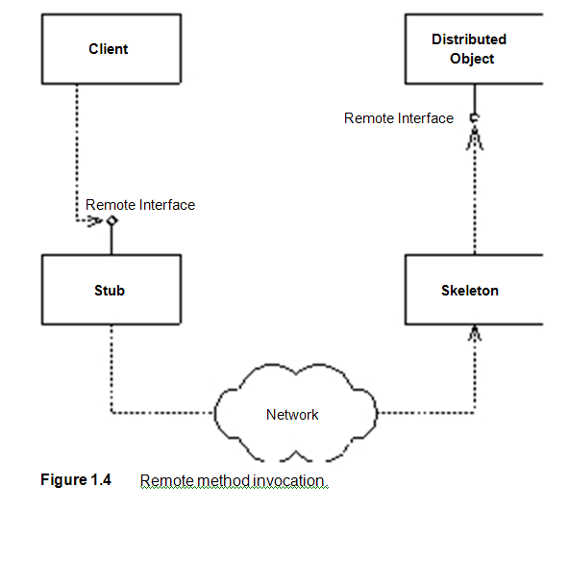
REMOTE METHOD INVOCATION
The client calls a stub, which is a client-side proxy object. This stub is responsible for masking network communications from the client. The stub knows how to call over the network using sockets and also how to massage parameters from their Java representations to the corresponding network representations.
The stub calls over the network to a skeleton, which is a server-side proxy object. The skeleton masks network communication from the distributed object. The skeleton understands how to receive calls on a socket as well as how to massage parameters from their network representations to their Java representations.
The skeleton delegates the call to the appropriate implementation object. This object serves the call and does its work, and returns control to the skeleton, which returns it to the stub, which finally returns control to the client.

Slide 7
REMOTE METHOD INVOCATION
A key point here is that both the stub and the server-side implementation object implement the same interface (called the remote interface). This means the stub clones the distributed object's method signatures. A client who calls a method on the stub thinks he is calling the distributed object directly; in reality, the client is calling an empty stub that knows how to go over the network. This is called distribution transparency. In fact, the distributed object is an abstraction that is created by the cooperation between the stub, skeleton, and implementation objects.
You can develop and deploy distributed objects using many other technologies, including CORBA (OMG), Distributed Component Object Model or
DCOM ( Microsoft), and Java RMI-IIOP (Sun).

Slide 8
WHY EJB
Portability:- Since EJB is a standard, you do not need to gamble on the long-term viability and proprietary architecture of a single vendor. And although porting applications from one platform to another platform is easy.
Rapid application development:- Your application can be built faster because you get middleware infrastructure services such as transactions, pooling, security, and so on from the application server. Also, innumerable tools have been made available by vendors as well as the open source community over the years to do rapid application development using EJB.

Slide 9
JAVABEANS VS. EJB
Can be visible or invisible
Designed to run locally
Are described with Properties, BeanInfo classes and Customizers
May be used as an ActiveX control
Are always invisible
Are distributed executable components on a server
Are described with a Deployment Descriptor
Can not be used as a ActiveX control

Slide 10
EJB MIDDLEWARE SERVICES
Transaction management, persistence, messaging, security, clustering, and so on are the middleware services
There are two ways in which a framework such as EJB can provide middleware services explicitly and implicitly. To use explicit middleware services you must explicitly call the middleware services' APIs. Implicit middleware services can be used without having to write against the middleware APIs.
Explicit Middleware Approach :-
User code has to request the framework to provide the requisite services.
This explicit approach can be illustrated using pseudo-code. The following example shows a transfer method on the Bank distributed component that performs transfer of funds between two accounts.

Slide 11
EJB MIDDLEWARE SERVICES
transfer(Account account1, Account account2, long amount) {
// 1: Call middleware API to perform a security check
// 2: Call middleware API to start a transaction
// 3: Call middleware API to load rows from the database
// 4: Subtract the balance from one account, add to the other
// 5: Call middleware API to store rows in the database
// 6: Call middleware API to end the transaction
}
Business logic is intertwined with the logic to call these middleware APIs.
This approach has some major downsides:-
Lowers developer productivity:- developer has to write code to call middleware services.
Difficult to write:- for simple task lot of code is written.
Difficult to maintain:- If you want to change the way you consume
middleware services, you need to rewrite your code.

Slide 12
EJB MIDDLEWARE SERVICES
Implicit Middleware Approach:-
Using this approach, the framework would not only provide middleware services but also an easier way to use them
An implicit middleware framework will let you declare the middleware services that you need for your application in a separate descriptor file or even through simple annotations within the code
Hence, the code is clean and focused on business logic.
To use the earlier illustration, below is how the pseudo-code for the transfer method on the Bank component will look:
transfer(Account account1, Account account2, long amount)
{
// 1: Subtract the balance from one account, add to the other
}
At the time the preceding code is compiled, the framework will peruse the descriptor and/or annotations within the code (depending on the approach used) and will provide the requested middleware services

Slide 13
EJB MIDDLEWARE SERVICES
The upsides to this approach are:
Increases developer productivity:- Developers do not have to write the code for invoking middleware services. All they have to do is declare the services they require in a descriptor file or as annotations in the code itself. This increases their productivity.
Easy to write:- Since no code needs to be written to call middleware services, your component code is focused on business logic
Easy to maintain:- The separation of business logic and middleware logic is clean and maintainable. Changing middleware service consumption does not require changing application code.

Slide 14
EJB CONTAINER
The EJB container is the piece of software that implements the EJB specification.
The reason it is called a container is that it provides an environment within which EJB components live and breath.
The container supplies middleware services to the beans and manages them
More than 30 application servers have been certified by Sun Microsystems to date for previous versions of Java EE
some of the popular commercial application servers include BEA WebLogic, Sun Java System Application Server (formerly, Sun ONE Application Server), IBM WebSphere, and Oracle Application Server.
In the open source JBoss, Glassfish, and Apache Geronimo are the notable application servers.

Slide 15
EJB TOOLS
To facilitate EJB development and deployment, there are numerous tools you can use.
The EJB tools consists of several integrated development envi- ronments (IDEs) that assist you in rapidly building, debugging, and deploying components
Most IDEs provide a mechanism to design, develop, test, document, and deploy EJBs.
Some of the popular commercial and open source EJB IDEs are Borland JBuilder, OracleJDeveloper, BEA WebLogic Workshop, IBM WebSphere Studio Application Developer, Sun Microsystems Java Studio Enterprise, NetBeans, and Eclipse.

Slide 16
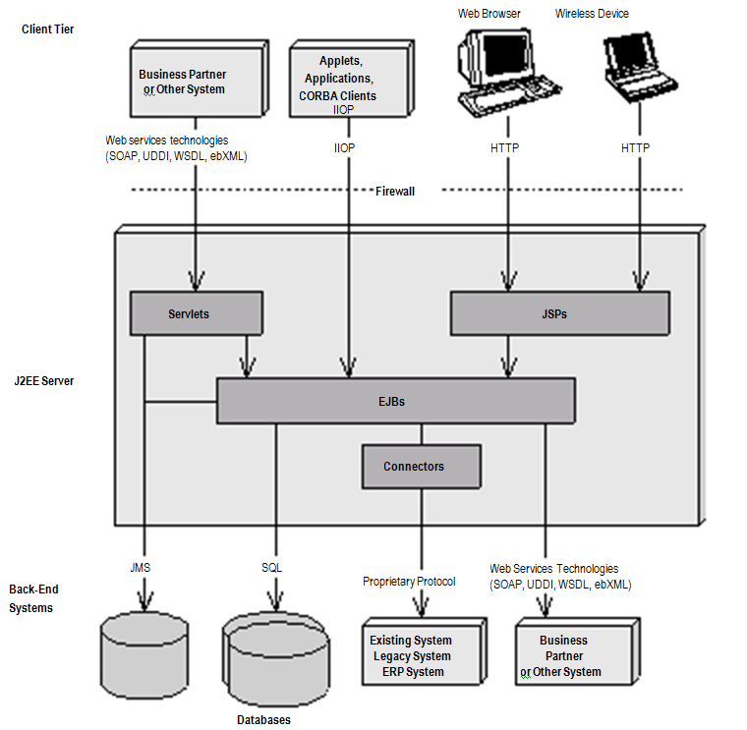
J2EE AND EJB

Slide 17
PRE-EJB 3.0 ENTERPRISE BEAN
An EJB component implementation has never been contained in a single source file; a number of files work together to make up an implementation of an enterprise bean.
Let us briefly go through these EJB implementation artifacts: -
Enterprise bean class:-
The primary part of the bean used to be the implementation itself ,which contained exact logic called as the enterprise bean class.
This was simply a Java class that conformed to a well-defined interface and obeyed certain rules. For instance, the EJB specification defined a few standard interfaces that your bean class had to implement. Implementing these interfaces forced your bean class to expose certain methods that all beans must provide, as defined by the EJB component model

Slide 18
PRE-EJB 3.0 ENTERPRISE BEAN
EJB object:-
When a client wants to use an instance of an enterprise bean class, the client never invokes the method directly on an actual bean instance. Rather, the invocation is intercepted by the EJB container and then delegated to the bean instance. By intercepting requests, the EJB container can provide middleware services implicitly. Thus, the EJB container acted as a layer of indirection between the client code and the bean. This layer of indirection manifested itself as a single network aware object called the EJB object.

Slide 19
PRE-EJB 3.0 ENTERPRISE BEAN
Remote interface:- A remote interface, written by the bean provider, consisted of all the methods that were made available to the remote clients of the bean. These methods usually would be business methods that the bean provider wants the remote clients of the bean to use. Remote interfaces had to comply with special rules that EJB specification defined. For example, all remote interfaces must be derived from the javax.ejb.EJBObject interface. The EJB object interface consisted of a number of methods, and the container would implement them for you.

Slide 20
PRE-EJB 3.0 ENTERPRISE BEAN
Local interface:- The local interface, written by the bean provider, consisted of all the methods that were made available to the local clients of the bean. Akin to the remote interface, the local interface provided business methods that the local bean clients could call. The local interface provided an efficient mechanism to enable use of EJB objects within the Java Virtual Machine (JVM), without incurring the overhead of RMI-IIOP. An enterprise bean that expected to be used by remote as well as local clients had to support both local and remote interfaces.

Slide 21
PRE-EJB 3.0 ENTERPRISE BEAN
Home interface:- Home interfaces defined methods for creating, destroying, and finding local or remote EJB objects. They acted as life cycle interfaces for the EJB objects. Each bean was supposed to have a corresponding home interface. All home interfaces had to extend standard interface javax.ejb.EJBHome or javax.ejb.EJBLocalHome, depending on whether the enterprise bean was local or remote. The container generated home objects implementing the methods of this interface at the time of deployment. Clients acquired references to the EJB objects via these home objects. Even though the container implemented home interfaces as home objects, an EJB developer was still required to follow certain rules pertaining to the lifecycle methods of a home interface. For instance, for each createXXX() method in the home interface, the enterprise bean class was required to have a corresponding ejbCreateXXX() method.

Slide 22
PRE-EJB 3.0 ENTERPRISE BEAN
Deployment descriptor:- To inform the container about your middleware needs, you as a bean provider were required to declare your components' middleware needs such as life-cycle management, transaction control, security services, and so on in an XML-based deployment descriptor file. The container inspected the deployment descriptor and fulfilled the requirements laid out by you. The deployment descriptor thus played the key role in enabling implicit middleware services in the EJB framework.
The Ejb-jar file:- The Ejb-jar file, the packaging artifact, consisted of all the other implementation artifacts of your bean. Once you generated your bean classes, your home interfaces, your remote interfaces, and your deployment descriptor, you'd package them into an Ejb-jar file. It is this Ejb-jar file that you, as a bean provider, would pass around for deployment purposes to application assemblers

Slide 23
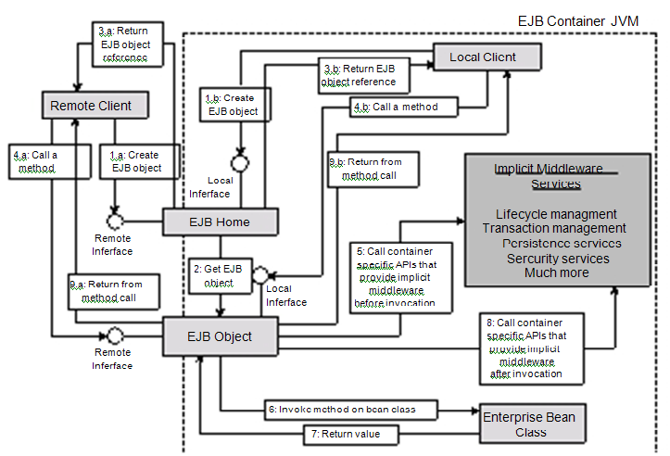
PRE-EJB 3.0 ENTERPRISE BEAN

Slide 24
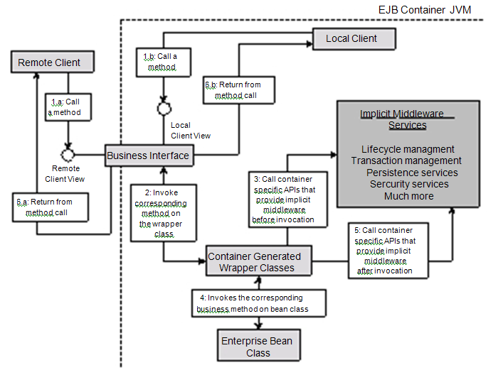
EJB 3.0 ENTERPRISE BEAN

Slide 25
THE EJB 3.0 SIMPLIFIED API
No home and object interfaces are required.
No component interface is required.
Use of Java metadata annotations.
Simplification of APIs for accessing bean's environment.

Slide 26
INTRODUCTION TO SESSION BEANS
A session bean instance is a relatively short-lived object. It has roughly the lifetime equivalent of a session or of the client code that is calling the session bean.
For example, if the client code contacted a session bean to perform order entry logic, the EJB container is responsible for creating an instance of that session bean component. When the client later disconnects, the application server may destroy the session bean instance.
The EJB container manages the bean's life cycle and is empowered to destroy session beans if clients time out.

Slide 27
SESSION BEAN SUBTYPES
The two subtypes of session beans are stateless session beans and stateful session beans.
Stateless Session Beans :-
A stateless session bean is a bean that holds conversations that span a single method call. They are stateless because they do not hold state that would be client-visible between invocations
After each method call, the container may choose to destroy a stateless session bean, or recreate it, clearing out all information pertaining to past invocations.
It also may choose to keep your instance around, perhaps reusing it for all clients who want to use the same session bean class. The exact algorithm is container-specific.

Slide 28
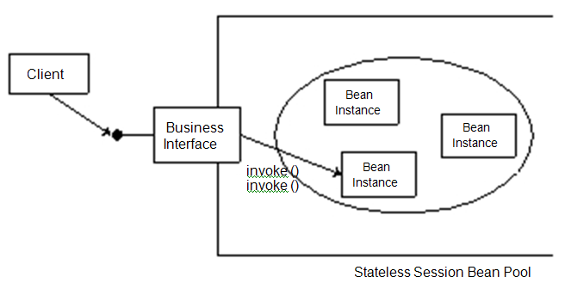
STATELESS SESSION BEANS
All instances of the same stateless session bean class are equivalent and indistinguishable to a client. It does not matter who has called a stateless session bean in the past,since a stateless session bean retains no state knowledge about its history. This means that any stateless session bean can service any client request because they are all exactly the same. In fact, stateless session beans can be pooled, reused, and swapped from one client to another client on each method call!

Slide 29
STATEFUL SESSION BEANS
A stateful session bean is a bean that is designed to service business processes that span multiple method requests or transactions. To accomplish this, stateful session beans retain state on behalf of an individual client.
If a stateful session bean's state is changed during a method invocation, that same state will be available to that same client upon the following invocation.
With stateful session beans, pooling is not as simple as with stateless session beans. When a client invokes a method on a bean, the client is starting a conversation with the bean, and the conversational state stored in the bean must be available for that same client's next method request. Therefore, the container cannot easily pool beans and dynamically assign them to handle arbitrary client method requests, since each bean is storing state on behalf of a particular client.

Slide 30
STATEFUL SESSION BEANS
If the conversational state that the beans are holding is large, the EJB server could easily run out of resources.
This was not a problem with stateless session beans because the container could pool only a few beans to service thousands of clients.
To limit the number of stateful session bean instances in memory, the container can swap out a stateful bean, saving its conversational state to a hard disk or other storage. This is called passivation.
After passivating a stateful bean, the conversational state is safely stored away, allowing resources like memory to be reclaimed.
When the original client invokes a method, the passivated conversational state is swapped in to a bean. This is called activation.
How does the container decide which beans to activate and which beans to passivate? The answer is specific to each container.
Most containers employ a least recently used (LRU) passivation strategy, which simply means to passivate the bean that has been called the least recently

Slide 31
STATEFUL SESSION BEANS
Passivation can occur at any time, as long as a bean is not involved in a method call. It's up to the container to decide when passivation makes sense.There is one exception to this rule: Any bean involved in a transaction cannot be passivated until the transaction completes.
To activate beans, most containers commonly use a just-in-time algorithm. Just in time means that beans should be activated on demand, as client requests come in. If a client request comes in, but that client's conversation has been passivated, the container activates the bean on demand, reading the passivated state back into memory.
At passivation time the container uses object serialization (or an equivalent protocol) to convert the bean's conversational state to a bit-blob and write the state out to disk.
Activation reverses the process: A serialized blob that had been written to storage is read back into memory and converted to in-memory bean data.

Slide 32
STATEFUL SESSION BEANS
Note that while your beans must follow the rules for object serialization,
The member variable is a nontransient primitive type.
The member variable is a nontransient Java object (extends java.lang.Object).
Your bean might also hold references to container-implemented objects. The container must preserve each of the following upon passivation/activation:
References to other beans' local or remote business interfaces
References to other beans' local or remote home interfaces (for code using the EJB 2.1 client view)
References to the SessionContext object, the UserTransaction, an EntityManager or EntityManagerFactory object, or a Timer object
JNDI naming contexts

Slide 33
STATEFUL SESSION BEANS
In many cases, the container will simply do this without your code having to bother, but sometimes your beans may contain state that is not covered by this contract with the container. For example, if your bean holds JDBC connections or open sockets or other nonserializable objects, then the container will not be able to properly activate and passivate the bean without a little assistance from the bean itself.
This assistance comes in the form of bean code that the container can call back during activation and passivation. The bean provider (that is, we, the developers) can provide this code as either individual callback methods in the bean, or as one or more separate callback listener classes

